Slide 1


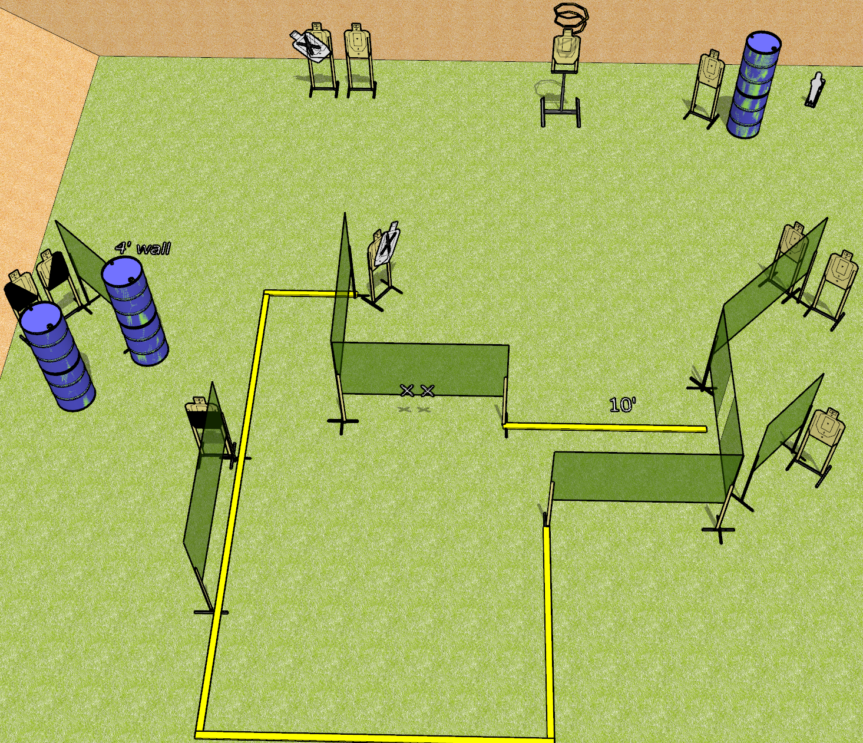
 | Dothan Gun Club – USPSA Match So Much To Do Course Designer : Drew Coleman
Round Count 23 rounds 11 USPSA targets 1 mini popper
Equipment List 14 wall feet 2 medium wall feet Drop turner + activator 1 50%, 1 left and 1 right diagonal

Slide 2
So Much To Do
Written Stage Briefing
So Much To Do is a 23 round, 115 point, Comstock course of fire. There are 11 USPSA targets and 1 mini popper. The best 2 hits on paper will score, and steel must fall to score. The start signal is audible.
The drop turner is activated by the mini popper and is visible at rest.
Handgun start position is hands touching marks. Handgun is loaded and holstered.
PCC start position is muzzle touching either mark, stock on belt. Loaded carbine is held with both hands, safety on.
On start signal, engage targets as they become available from within the shooting area.

Slide 3
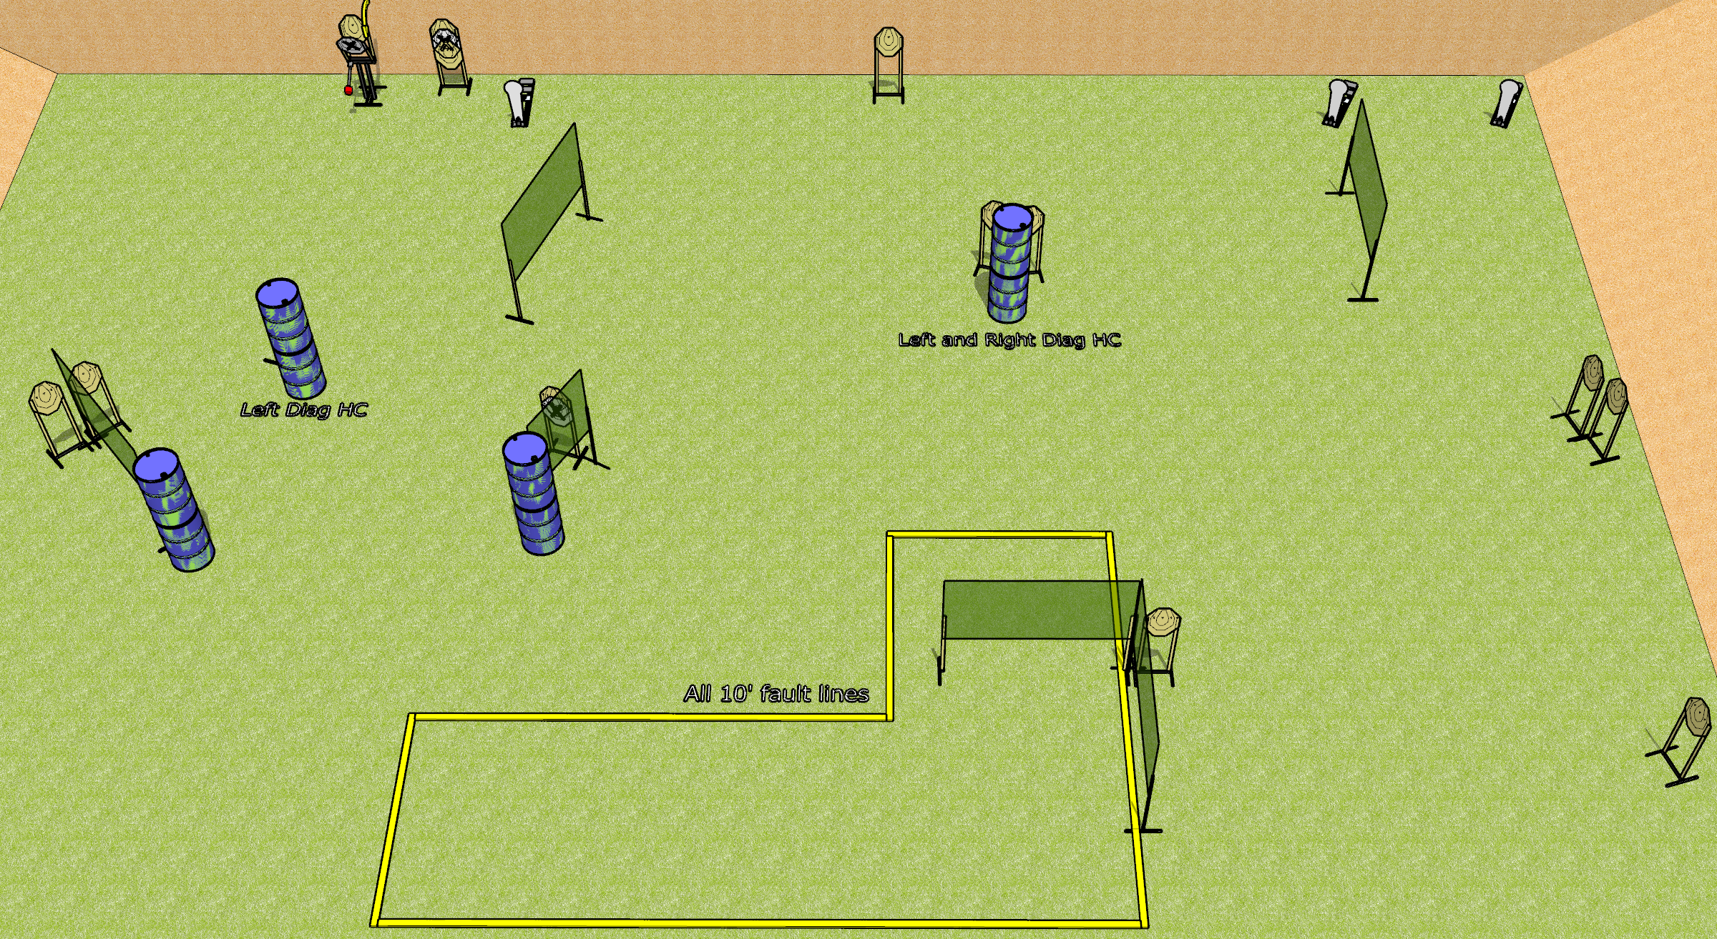
 | Dothan Gun Club – USPSA Match Big Expectations Course Designer : Drew Coleman
Round Count 31 rounds 14 IPSC 3 Colt poppers
Equipment List 11 wall feet 10 10’ fault lines Max trap + activator 2 left diag, 1 right diag

Slide 4
Big Expectations
Written Stage Briefing
Big Expectations is a 31 round, 155 point, Comstock course of fire. There are 14 IPSC targets and 3 colt poppers. The best 2 hits on paper will score, and steel must fall to score. The start signal is audible.
The Max Trap is activated by the left colt popper and remains visible at rest.
Handgun start position is inside the shooting area, wrists below belt. Handgun is loaded and holstered.
PCC start position is inside the shooting area, stock on belt. Loaded carbine is held with both hands, safety on.
On start signal, engage targets as they become available from within the shooting area.

